Slide 1
Introducing IGS (Informative Genomic Segment)
enabling scalable diversity analysis of metagenomes without the need for assembly or reference sequences
Qingpeng Zhang
Department of Computer Science and Engineering
Michigan State University
Supervisor: Dr. Titus Brown @qingpengzhang
Notes:
Good afternoon, thanks for coming to my talk.
I am qingpeng, I am grad student I work with Titus Brown.
Here I am glad to Introduce IGS. Which is an acronym I coined, and aproved by titus, which means informative genomic segment.. I will introduce how I come up with this concept and how it can be used to enable scalable diversity……, especially without the need for assembly or reference.

Slide 2
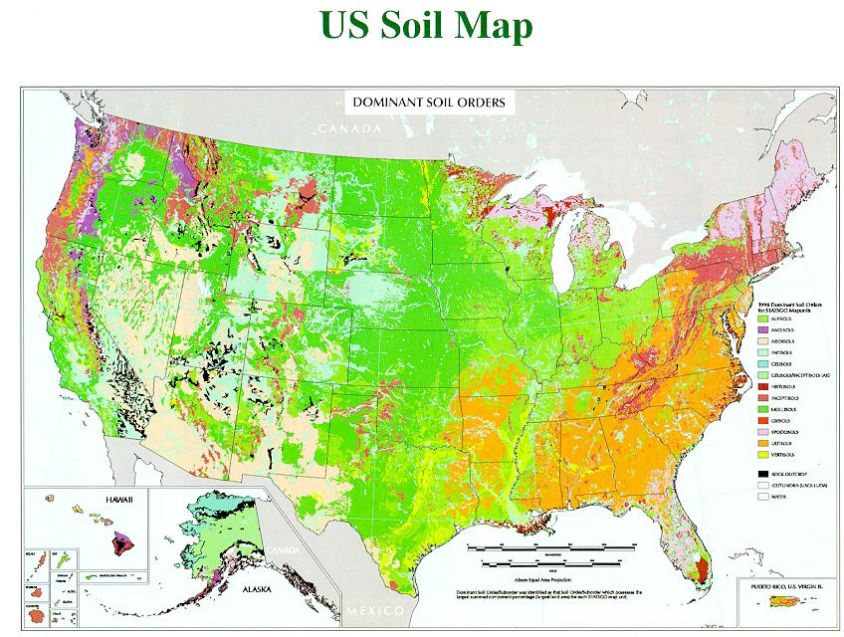
The Great Prairie Grand Challenge
How many different species in a soil sample? What is their abundance distribution? (alpha-diversity)
How different are the soil samples from 100-year cultivated Iowa agricultural soil and native Iowa prairie? (beta-diversity)
Notes:
The direct motivation of this work is GPGC project. Which is The Great Prairie Grand Challenge. It is an effort to analyze cultivated and natural soil from several different locations in specifically Kansas, Iowa, and Wisconsin. We want to answer important questions like how many different species in a soil sample? What is their abundundance distirbution?
Is there any difference between differen samples like iowa cultured soil and preparie soil
There are classic diversty estimation problem in microbial ecology. The first two are alpha diversity, the diversity in one defined habitat or sample, the last is about beta diversity,to compare diversity between samplesor habitats.

Slide 3
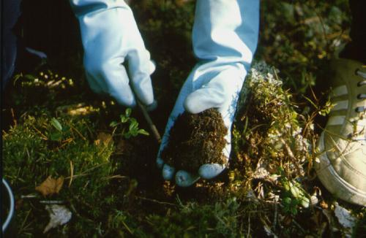
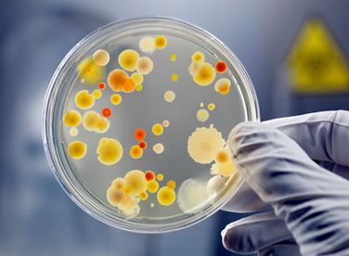
“Grand Challenge”
”...functional analysis of the collective genomes of soil microflora, which we term the metagenome of the soil.”
- J. Handelsman et al., 1998
most of the microorganisms can not be cultured and isolated and sequenced in traditional way.
In a gram of soil, there are approximately a billion microbial cells, containing an estimated 4 petabase pairs of DNA (Jack A. Gilbert,2013)
+
Improvement of next generation sequencing = data deluge
+
Decreasing cost of sequencing
Notes:
Why it is called grand challenge.
Firstly, millions of species in soil it is most of the microorganisms can not be cultivated and …. So we use metagenomic approach to sequeing everything in a sample wihtout filtering. The work metaggenome was created to describe the challenge to deal with soil. 16 years ago.
What’s more, the soil sample is so divese, there are , millions of species of bacterials, . Billions of es.f s
So we need a lot of sequencing effort. Forutunatley or unfortunately , With th eimprovement of techno and , we are getting more and more sequencing reads now in a faster and faster rate. So this is ear of The data deluge
Actually we hae got over 1t by data from iowa ,,.. ..

Slide 4

Metagenomics and Next Generation Sequencing
”...functional analysis of the collective genomes of soil microflora, which we term the metagenome of the soil.”
- J. Handelsman et al., 1998
most of the microorganisms can not be cultured and isolated and sequenced in traditional way.
In a gram of soil, there are approximately a billion microbial cells, containing an estimated 4 petabase pairs of DNA (Jack A. Gilbert,2013)
+
Improvement of next generation sequencing = data deluge
+
Decreasing cost of sequencing

Slide 5
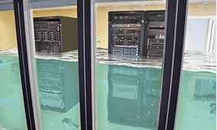
Metagenomics and Next Generation Sequencing
”...functional analysis of the collective genomes of soil microflora, which we term the metagenome of the soil.”
- J. Handelsman et al., 1998
most of the microorganisms can not be cultured and isolated and sequenced in traditional way.
In a gram of soil, there are approximately a billion microbial cells, containing an estimated 4 petabase pairs of DNA (Jack A. Gilbert,2013)
+
Improvement of next generation sequencing = data deluge
+
Decreasing cost of sequencing
http://www.e-janco.com/
Notes:
This data deluge will not only flood your laptop , but also flood the super computer. Hpc stuff want to know why I need so much storage space. I will tell you why I wam working on soil metagenomic data. Sorry about the flooding

Slide 6
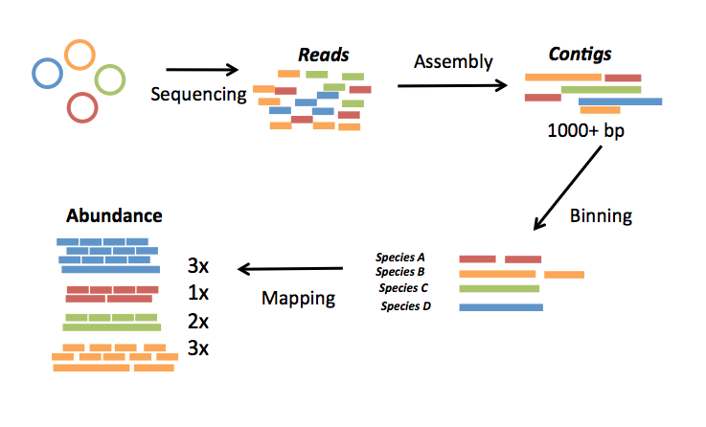
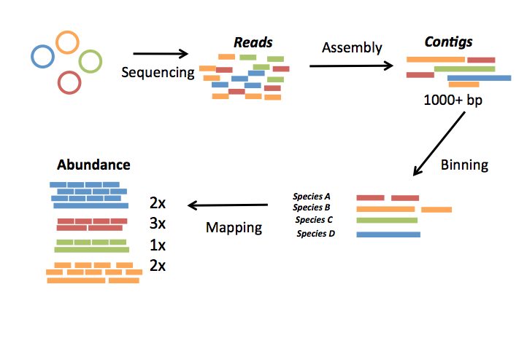
A typical pipeline of metagenome diversity analysis
Sample1
Reads
Assembly
Contigs
Sequencing
1000+ bp
100-150 bp
Abundance
Species
Binning
3x
1x
1x
2x
Species A
Species B
Mapping
Species C
Species D
 | Sample1 | Sample2 | Sample3 | Sample4 | Sample5
Species A | 3 | 3 | 4 | 4 | 0
Species B | 1 | 3 | 0 | 2 | 2
Species C | 1 | 2 | 2 | 2 | 3
Species D | 2 | 1 | 2 | 1 | 1
Sample5
Sample4
Sample3
Sample2
Loosely based on slide by Mads Albertsen
Notes:
Ok to answer the diversity question like how different two soil samples are. Here I will introduce a typical p l of m d analysis.
Firstly. We do sequencign, got reads, then do assemlby, longer, do bining, classify into species, or unit, then map reads back to species, contigs, to get the abundance , do this to every sampke, we get a table with the abundance of species, across sample,s whichi fotern claled samples by species matrix.

Slide 7
 | Sample1 | Sample2 | Sample3 | Sample4 | Sample5 | Sample6
SpeciesA | 3 | 3 | 4 | 4 | 0 | 0
SpeciesB | 1 | 3 | 0 | 2 | 2 | 2
SpeciesC | 1 | 2 | 2 | 2 | 3 | 3
SpeciesD | 2 | 1 | 2 | 1 | 1 | 1
SpeciesE | 4 | 1 | 3 | 0 | 2 | 5
SpeciesF | 5 | 1 | 2 | 2 | 2 | 5
SpeciesG | 2 | 2 | 1 | 2 | 1 | 3
SpeciesG | 4 | 1 | 3 | 0 | 2 | 5
 | 5 | 1 | 2 | 2 | 2 | 5
 | 2 | 2 | 1 | 2 | 1 | 3
Alpha diversity: “How many different species in a soil sample?”
Beta diversity: “How different are the soil samples”
Notes:
With this samples by species matrix, we can get similarity matrix between samples and do alpha diversity analysis or beta divesity to compare samples.

Slide 8
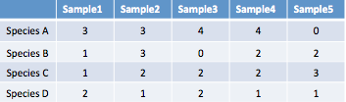
A typical pipeline of metagenome diversity analysis
Sample1
Reads
Assembly
Contigs
Sequencing
1000+ bp
100-150 bp
Abundance
Species
Binning
3x
1x
1x
2x
Species A
Species B
Mapping
Species C
Species D
Samples by species table
Challenges:
Assembly? - difficult (eg. Only small portions of reads can be assembled)
Loosely based on slide by Mads Albertsen
Notes:
Ok ti loks streagith forwad, but if we revisit the pipeline, or run the pipleine actuall,ly, we know not so easy, facing chanllge
Firstlyl, assbmly is difficlulty ,. Oly small, can be assembled,
Yes. We can .
What is IGSs.
Igs represent the novel information in a sample.

Slide 9
A typical pipeline of metagenome diversity analysis
Sample1
Reads
Assembly
Contigs
Sequencing
1000+ bp
100-150 bp
Abundance
Species
Binning
3x
1x
1x
2x
Species A
Species B
Mapping
Species C
Species D
Samples by species table
Challenges:
Binning? – difficult (eg. may need reference genomes, computationally expensive)
Loosely based on slide by Mads Albertsen
Notes:
Next step binning, is not better, also difficulty, two methods similarity based, and composition based, need reference , computa expensive.
Can we do diversity analysis , get the species by sample table without need for assembly, binning, mapping??
Assembly,binning, mapping, are important, for function. Phylogentic , for now for the purpose of diversity analysis, compare etagen samples, can we avoid them? And do directly??
Wht we need to do is replace…
Yes. We can .
What is IGSs.
Igs represent the novel information in a sample.

Slide 10
A typical pipeline of metagenome diversity analysis
Sample1
Reads
Assembly
Contigs
Sequencing
1000+ bp
100-150 bp
Abundance
Species
Binning
3x
1x
1x
2x
Species A
Species B
Mapping
Species C
Species D
Samples by species table
Challenges:
Mapping? – difficult (eg. accuracy, computationally expensive)
Loosely based on slide by Mads Albertsen
Notes:
Mapping,normally is computationally expensive, we are taling about
Yes. We can .
What is IGSs.
Igs represent the novel information in a sample.

Slide 11
A typical pipeline of metagenome diversity analysis
Sample1
Reads
Assembly
Contigs
Sequencing
1000+ bp
100-150 bp
Abundance
Species
Binning
3x
1x
1x
2x
Species A
Species B
Mapping
Species C
Species D
Samples by species table
Challenges:
Assembly? - difficult (eg. Only small portions of reads can be assembled)
Binning? – difficult (eg. may need reference genomes, computationally expensive)
Mapping? – difficult (eg. accuracy, computationally expensive)
4 petabase pairs of DNA in a gram of soil(Jack A. Gilbert,2013)
Notes:
Mapping,normally is computationally expensive, we are taling about
Don’t forget the scary number of 4 pteabased. Trribase sequencign, dataset, painful to do mapping , blaoor bowtie.
So the wuqesiton is can we find a shortcut, to do diversity anslyiss, alike get the clustering, without ….
The answer is yes we can.
Althought,
Assembly,binning, mapping, are important, for function. Phylogentic , for now for the purpose of diversity analysis, compare etagen samples, it is possible to avoid the process.
What we will do is to get replacie the sampels by species table by ssample sby other unit.

Slide 12
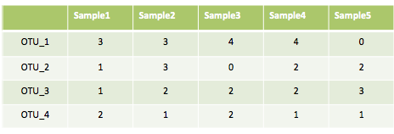
A typical pipeline of metagenome diversity analysis
Sample1
Reads
Assembly
Contigs
Sequencing
1000+ bp
100-150 bp
Abundance
Species
Binning
3x
1x
1x
2x
Species A
Species B
Mapping
Species C
Species D
Species-by-sample table
Challenges:
Assembly? - difficult (eg. Only small portions of reads can be assembled)
Binning? – difficult (eg. may need reference genomes, computationally expensive)
Mapping? – difficult (eg. accuracy, computationally expensive)
4 petabase pairs of DNA in a gram of soil(Jack A. Gilbert,2013)
Notes:
We may nknow the definition of specis in mic is ambigous. It is diffuclty to distincgwaish, people have alreadsy used oTU to replace species as the unit for diversity, analysis. The otu taxonomy can represnet the 16 s rna reads that are similar with each other.

Slide 13
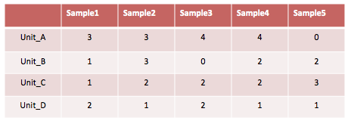
A typical pipeline of metagenome diversity analysis
Sample1
Reads
Assembly
Contigs
Sequencing
1000+ bp
100-150 bp
Abundance
Species
Binning
3x
1x
1x
2x
Species A
Species B
Mapping
Species C
Species D
Species-by-sample table
Challenges:
Assembly? - difficult (eg. Only small portions of reads can be assembled)
Binning? – difficult (eg. may need reference genomes, computationally expensive)
Mapping? – difficult (eg. accuracy, computationally expensive)
4 petabase pairs of DNA in a gram of soil(Jack A. Gilbert,2013)
Notes:
Ew want to find other unit that can be defined and the count can be aquried from wholge gnoem shto reads.
This wi where we need IGS.

Slide 14
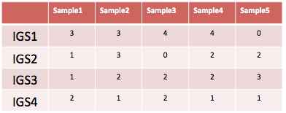
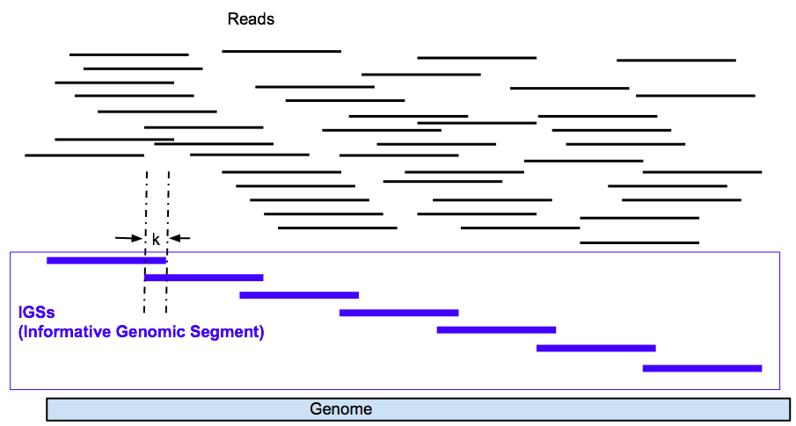
Replace samples-by-species table with samples-by-IGSs table
IGS (informative genomic segment)
can be used as a new unit to do diversity analysis to replace species/OTUs
can represent the novel information of a genome
Assembly-free
Reference-free
Efficient and scalable
Notes:
We can get the count of igs across samples from raw reads. It can be used.
It is can represent. The after after we get the table, there are a bunch of existing tools to do analysis downstream .
Next I will itnroduce how to get the table from if we only have the sequencing reads in diff samples.

Slide 15
We have an efficient method to get read coverage profile across samples
Efficient software to count k-mers – khmer (Zhang et al, 2014)
Using median k-mer frequency can represent the coverage of the read in a sample (Brown et al, 2012)
Sample A
Sample B
Coverage = 10
Reads are noisy observations of genomic regions.
Notes:
Firslty, a technique that is critical to the countign, igs, now we have an efficient methods to get…
This is based. On khmer and another method diginorm. I want to say without these work , all the igs realed stuff is jus timporssible.
We can get the coverage of a read in a sampke where it is from. Like this 10 co

Slide 16
Sample A
Sample B
Coverage = 5
Reads are noisy observations of genomic regions.
Notes:
The same, another ,reads,

Slide 17
Sample A
Sample B
Coverage = 8
Reads are noisy observations of genomic regions.
Notes:
More important ,we can get the coverage of read afomr sample a in sample b. we keep in mind that ereatea dare …
So a reads has a coverage in b. means, the genomic regions are observed by reads in both samples,. Genomic region occurs ii both sample.s

Slide 18
3:
Sample A
Coverage=3
Sample B
Sample C
Notes:
Ok ,with the technique to get the covrareage of a read in any smaples, wsupos we have 34 samples, we will check coerage of a read in sample as acorrss 3 samples, like

Slide 19
3:
2
Sample A
Sample B
Coverage=2
Sample C

Slide 20
3:2:
2
Read coverage profile:
Sample A
Sample B
Sample C
Coverage=2

Slide 21
3:
Sample A
3:2:2
Coverage=3
Sample B
Sample C
Notes:
For every reads in sample b, we can still

Slide 22
3:2:2
2:4:3
2:0:3
Sample A
3:2:2
3:2:2
2:0:3
2:0:3
3:2:2
3:2:2
3:2:2
2:4:3
2:0:3
“Contigs with similar coverage profiles are likely to have originated from the same microbial population” (Imelfort et al. 2014)
Reads with similar coverage profiles are likely to have originated from the same genomic region.
Sample B
3:2:2
2:4:3
2:4:3
3:2:2
2:4:3
3:2:2
2:4:3
3:2:2
3:2:2
Sample C
2:0:3
2:4:3
2:4:3
2:0:3
2:0:3
3:2:2
3:2:2
2:0:3
2:0:3
2:4:3
2:0:3
3:2:2
Notes:
So we can get all the coverage profiles of all the reads in sample.s
I nned to quote a notion here, contigs. With ,
Siilarl , reads the same,
We group reads together with same profiles. They are likely be the observations of the same genomic regions.

Slide 23
3:2:2
2:4:3
2:0:3
3:2:2
3:2:2
2:0:3
2:0:3
3:2:2
3:2:2
3:2:2
2:4:3
2:0:3
6/3 = 2
4/2 = 2
2/2 = 1
Genomic Content Sample A
IGS(informative genomic segment)
3:2:2
2:4:3
2:4:3
3:2:2
2:4:3
3:2:2
2:4:3
3:2:2
Do the reads in each bin cover the same size of genomic region?
6 reads with coverage of 3 in the sample where they are from
Genomic Content Sample B
3:2:2
VS
2:0:3
2:4:3
2:4:3
2:0:3
2:0:3
2 reads with coverage of 2 in the sample where they are from
3:2:2
3:2:2
2:0:3
2:4:3
Super bin 1
2:0:3
Super bin 2
Super bin 3
2:0:3
3:2:2
Genomic Content Sample C
Notes:
“Super bin” , we can not say we splti into species. Into genomic regions. Are covered by group reads.
Next we want to ask. Do the the same szie?? Actuall not. Let’s look at this. Twice as large as the region this two reads cover.
The unit will be IGSs.
Do they cover the same size of segment on the genome? No.

Slide 24
3:2:2
3:2:2
2:0:3
2:0:3
2:4:3
3:2:2
3:2:2
2:0:3
2:0:3
2:4:3
3:2:2
3:2:2
 | SampleA | SampleB | SampleC
IGS1 | 3 | 2 | 2
IGS2 | 3 | 2 | 2
IGS3 | 2 | 0 | 3
IGS4 | 2 | 0 | 3
IGS5 | 2 | 4 | 3
2:4:3
3:2:2
3:2:2
2:4:3
3:2:2
3:2:2
2:4:3
2:4:3
3:2:2
3:2:2
2:4:3
2:0:3
2:0:3
3:2:2
3:2:2
2:0:3
2:0:3
2:4:3
2:0:3
2:0:3
2:4:3
Notes:
With this diferent igs and the coerage, observeance, it is easy to have sample by igs matirx like this.
If they are have similar coverage profile,
Get the number of segments.
How many stuffs
Cover more stuffs than this one, twice as large as smaller one

Slide 25
A typical pipeline of metagenome diversity analysis
Sample1
Reads
Assembly
Contigs
Sequencing
1000+ bp
100-150 bp
Abundance
Species
Binning
3x
1x
1x
2x
Species A
Species B
Mapping
Species C
Species D
Species-by-sample table
Challenges:
Assembly? - difficult (eg. Only small portions of reads can be assembled)
Binning? – difficult (eg. may need reference genomes, computationally expensive)
Mapping? – difficult (eg. accuracy, computationally expensive)
4 petabase pairs of DNA in a gram of soil(Jack A. Gilbert,2013)
Notes:
Now we have igs and we find the short cut, and do diversity anslsyis.

Slide 26
IGS(informative genomic segment) can represent the novel information of a genome
The more IGSs there are in a sample, the higher diversity , higher richness the sample has.
The more IGSs two samples share, the more similar the two samples are.
Notes:
So wha tare the IgS exactly. It seems abstract.but in fact we can consider them as the genomic segments, which do not share more than 1 kmer with each other. Sinply put, igss can represent thenovel information in a genome. The more igs there are in a sample, the higher diversity , higher richness th esample has. The more igs two samples share, the mor similar the two samples are.

Slide 27
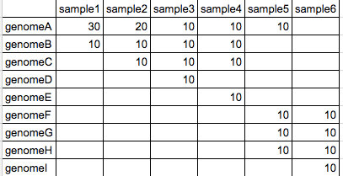
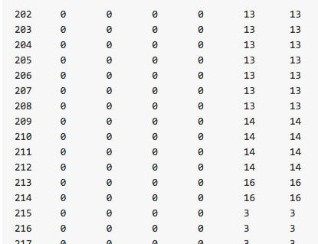
Simulated data sets with different species composition
Bray-curtis dissimilarity matrix
 | S1 | S2 | S3 | S4 | S5 | S6
S1 | 0.0 | 0.25 | 0.5 | 0.5 | 0.75 | 1.0
S2 | 0.25 | 0.0 | 0.25 | 0.25 | 0.75 | 1.0
S3 | 0.5 | 0.25 | 0.0 | 0.25 | 0.75 | 1.0
S4 | 0.5 | 0.25 | 0.25 | 0.0 | 0.75 | 1.0
S5 | 0.75 | 0.75 | 0.75 | 0.75 | 0.0 | 0.25
S6 | 1.0 | 1.0 | 1.0 | 1.0 | 0.25 | 0.0
Samples-by-IGSs matrix
Notes:
Let’s see how it works in real world.
Firstly check the simiulated datadst.
6
Got igs and

Slide 28

AFGH
FGHI
ABCE
AABC
ABCD
AAAB
ABCD
FGHI
ABCE
AFGH
AABC
AAAB
Notes:
next use a test data set, with different diversity,
different species, different abundance.
igs. got saturation curve. match the hypothesis pretty good. the
Y axis the nubmer of igs in as we load more reads
Match the real composite in samples.
The smapels with more species insidde has higher diversity , more numbe rof igs .
Also we can cluste rby the similarty between smaples.

Slide 29
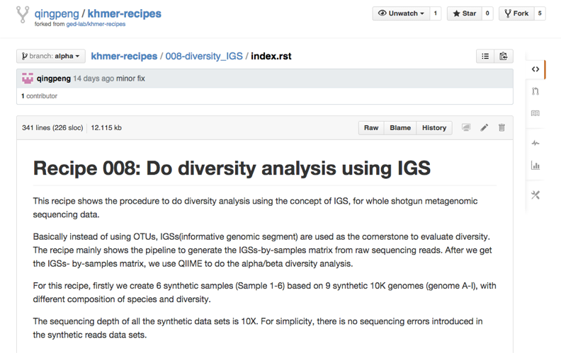
AFGH
FGHI
ABCE
AABC
ABCD
AAAB
ABCD
FGHI
ABCE
AFGH
AABC
AAAB
https://github.com/qingpeng/khmer-recipes/tree/alpha/008-diversity_IGS
Notes:
Reproducibale. The test datst and script are all in github you can git clone and try it it by yyoureeilf. Try your datset. Using ghis

Slide 30
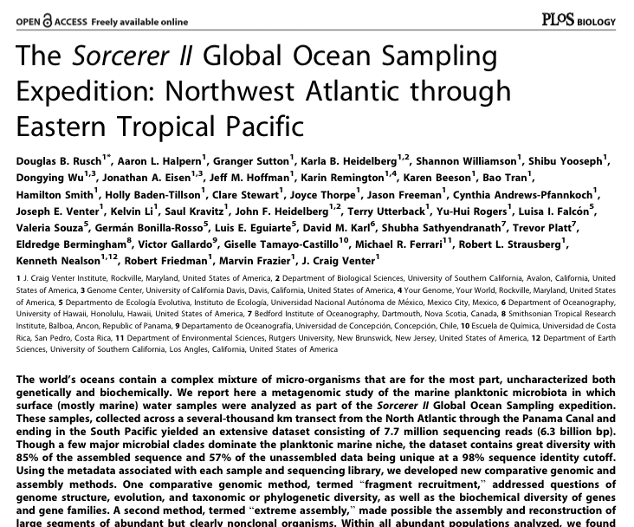
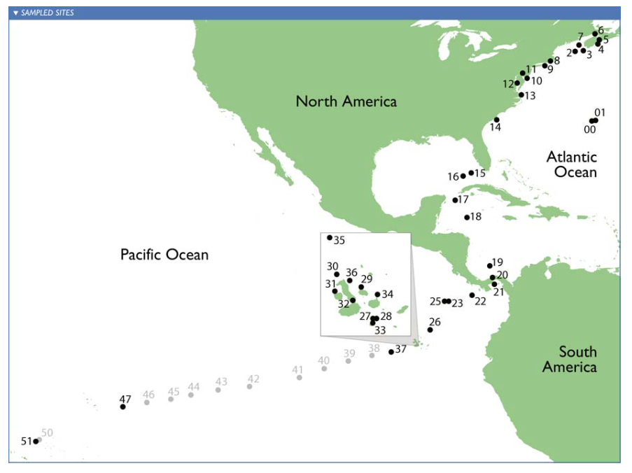
Sorcerer II Global Ocean Sampling Expedition
Notes:
Reasl data et, the sea water got sampled in diffenrelnt locations. Got sequenced. Got ther eaed with
Using igs methods.

Slide 31






Rusch DB, Halpern AL, Sutton G, Heidelberg KB, Williamson S, et al. (2007) The Sorcerer II Global Ocean Sampling expedition: Northwest Atlantic through eastern tropical Pacific.
Cluster from IGS-based method is as good as cluster in original paper from alignment-based method
or
Better?
Notes:
alpha, we pretty much the same cluster, put two sampels in the right place. better than the original paper
Using igs methods. Can get as good if not better cluster compared to . Two difference we think our clusteringmake smore sense.

Slide 32
Rusch DB, Halpern AL, Sutton G, Heidelberg KB, Williamson S, et al. (2007) The Sorcerer II Global Ocean Sampling expedition: Northwest Atlantic through eastern tropical Pacific.
Notes:
alpha, this is new, abundant, look like more diverse tropical north temperate. o data we can get this conclusion using the method

Slide 33
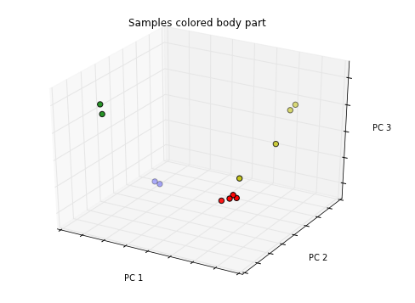
HMP(Human Microbiome Project)
I picked the smallest 12 samples from ~700 HMP samples with 3 groups from different body parts. (skin, oral, vaginal).
- red: anterior_nares - skin
- green: throat - oral
- blue: buccal_mucosa - oral
- yellow: posterior_fornix - vaginal

Slide 34
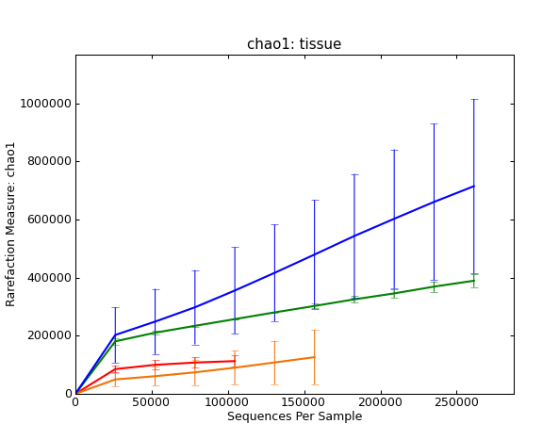
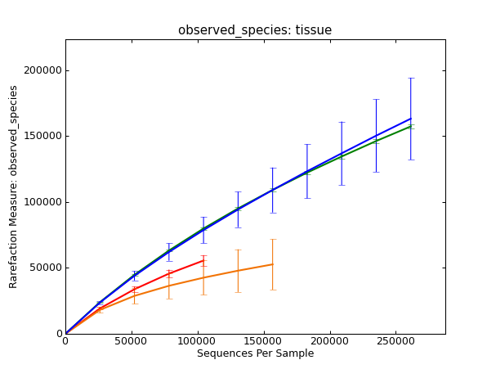
HMP(Human Microbiome Project)
- red: anterior_nares - skin
- green: throat - oral
- blue: buccal_mucosa - oral
- yellow: posterior_fornix - vaginal

Slide 35
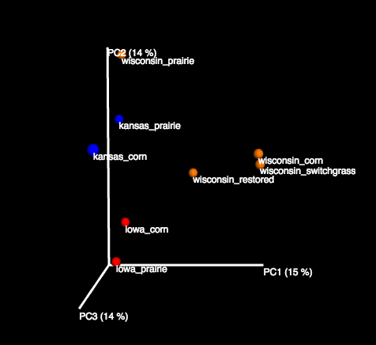
Some soil samples – GPGC data (1m reads subset)

Slide 36
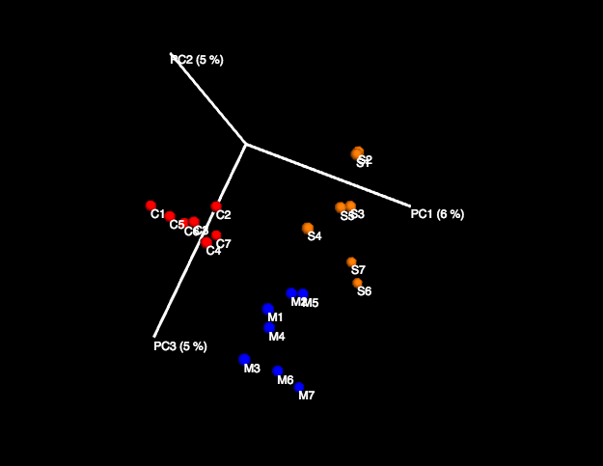
Some soil samples – KBS samples(1m reads subset)
C :corn
S : switchgrass
M : miscanthus

Slide 37
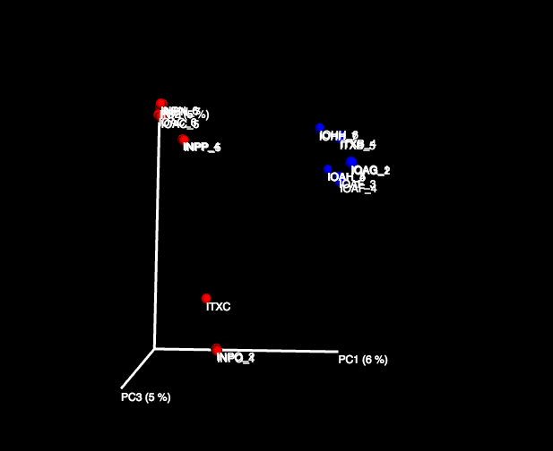
Some soil samples – ARMO (1m reads subset)
Blue: Prairie
Red: Forest

Slide 38
Summary
IGS (informative genomic segment)
A new unit to represent novel information in metagenome
A new framework to do diversity analysis
Assembly-free, reference-free
extremely diverse microbial communities (Soil, etc.)
Samples abundant with “dark matter”
Efficient and scalable (Memory and Time)
Based on efficient k-mer counting tool – khmer
Efficient method to get read coverage profile across samples
Linear with the number of samples, size of reads data set.
Enable analysis of extremely large shotgun metagenomic data sets (Terabytes, etc.)

Slide 39
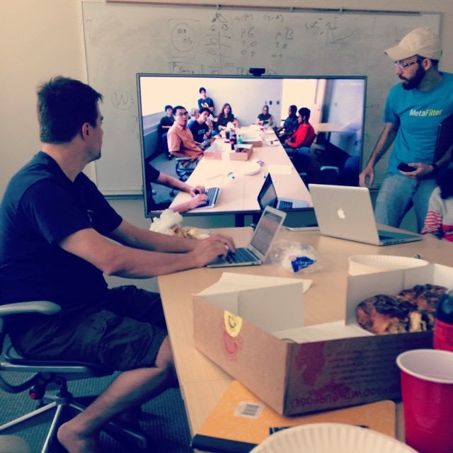
Acknowledgement
Dr. Titus Brown
Lab members of GED
Dr. Sherine Awad
Michael Crusoe
Jiarong Guo
Luiz Irber
Elijah Lowe
Camille Scott
Former members of GED
Dr. Adina Howe
Eric McDonald
Dr. Jason Pell
Dr. Likit Preeyanon
RDP
Dr. Jim Cole
Jordan Fish
Other khmer developers

Slide 40
What’s next
More real data sets
HMP(Human microbiom project)
Ballast water virus (collaboration with Dr. Joan Rose)
Soil samples (full data set, benchmark scalability)
GPGC (The Great Prairie Grand Challenge)
ARMO (Amazon rainforest)
KBS samples
Extend applications beyond diversity analysis
Reads binning/classification based on reads coverage profile
Genome size estimation/sequencing effort evaluation
Relate IGSs to function/species
co-assembly
Refine pipeline, optimize performance
Adjust IGS resolution (like using super-bin instead)
Influence of read size
Choose statistical models that fit IGS best

Slide 41
Improve the pipeline
khmer
diginorm
Notes:
to real data set, big , and error, used several methods, to impveo, 1. filter short reads, do error, use ophtimal sfa, all require khmer , diginor, i participate. all the effort paid off. here.

